Slide 1
COVID-19 West Java
By Himawan Adityas

Slide 2
Introduction
Covid-19 pandemic has spreaded to a whole countries in the world, one of coutries is Indonesia.
Every single day, amount of residents that infected increase from tens to thousands and nowaday that amount of residents infected were more than a million
Reducing infected spread rate of Covid-19 in Indonesia.

Slide 3
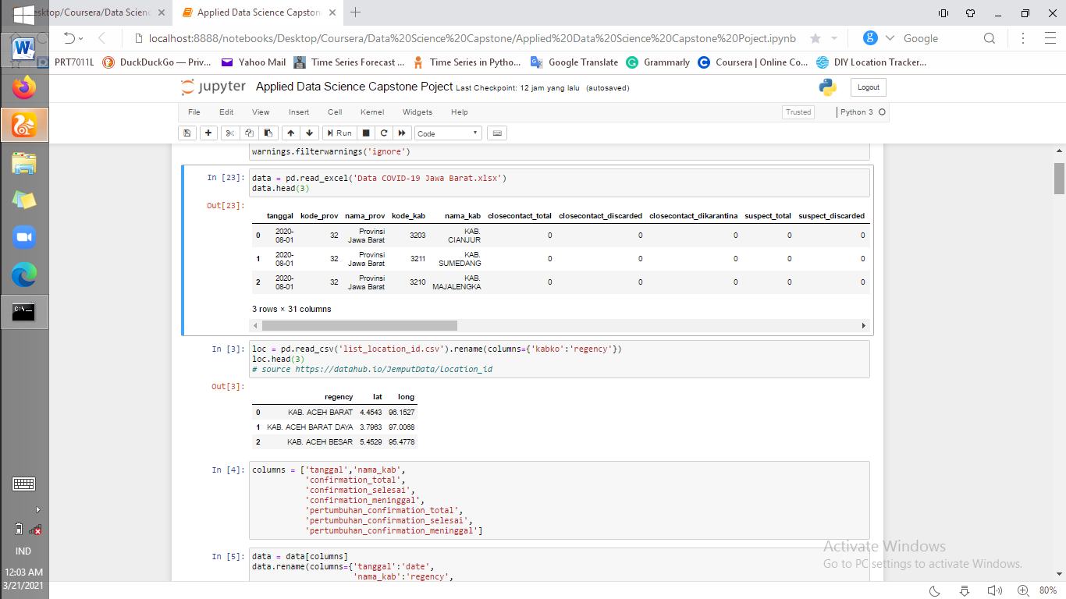
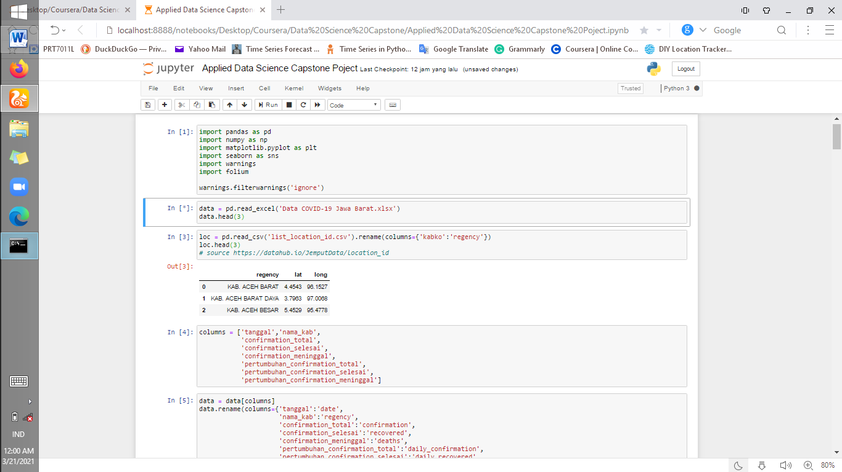
Data
Infect spread rate of covid-19 form each regencies in West Java
Geospatial data of regencies in West Java

Slide 4
Methodology
Importing the data form PIKOBAR JAWA BARAT and geospatial data of regencies.
Change the column name and drop the data which regencies data is unknown regencies.
Change data type of date column to datetime data type using pd.to_datetime().
Using only 8 columns of covid-19 data.
Merging the covid-19 data with geospatial data by regencies using pd.merge().
Visualizing total confimation, recovered, and deaths cases in the last of date using matplotlib.
Visualizing bubble marker map of total confimation, recovered, and deaths cases for each regencies in the last of date using folium.
Visualizing the 6 highest of daily case rate of confirmation, and deaths cases for each regencies

Slide 5
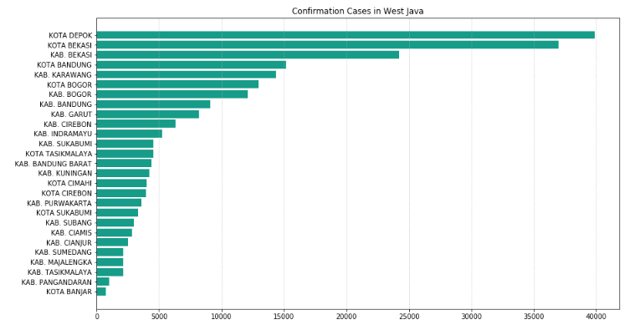
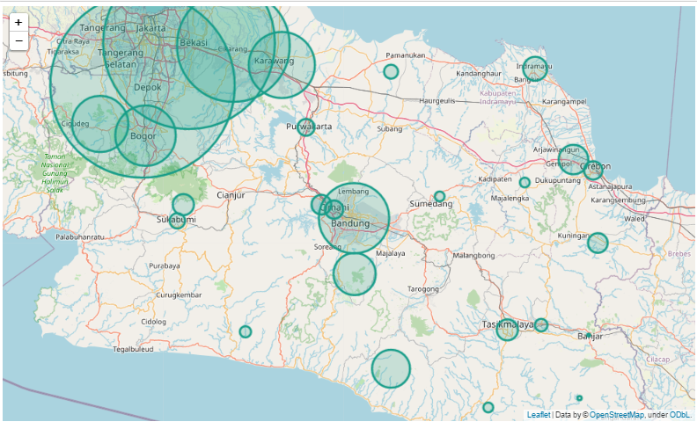
Results

Slide 6
In Fig 4.1 there is a graph visualizing the total confirmation cases for each regencies. In the graph, Depok City occupies the highest position, reaching nearly 40,000 (fourty thousand) cases and followed by Bekasi City in the second place with a total of more than 35,000 (thirty five thousand) cases. In contrast, the first and second lowest total cases occurred in Banjar regency and Pangandaran regency where the total cases were only less than 2,000 cases. From these data, the main factor of the rate of distribution is the distance from the city center, capital city and regional and national business centers. Because of this, a lot of people came and went out of that area or city. Like the Depok city and Bekasi city, the two cities are very close to the national business center and at the same time the capital city of Jakarta so that a lot of people who come from Jakarta go to Depok and Bekasi cities and vice versa. So that the spread rate becomes fast. It should be noted that Jakarta is the city with the highest cases in Indonesia. For more details, as in Fig 4.2 which illustrates that the city of Depok and Bekasi are close to Jakarta.

Slide 7
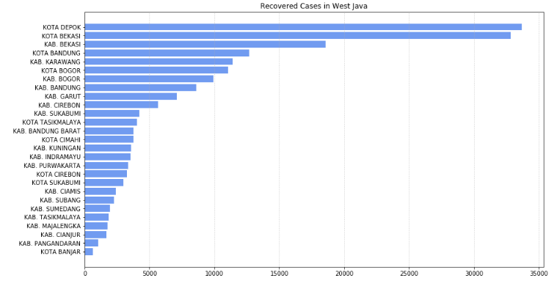
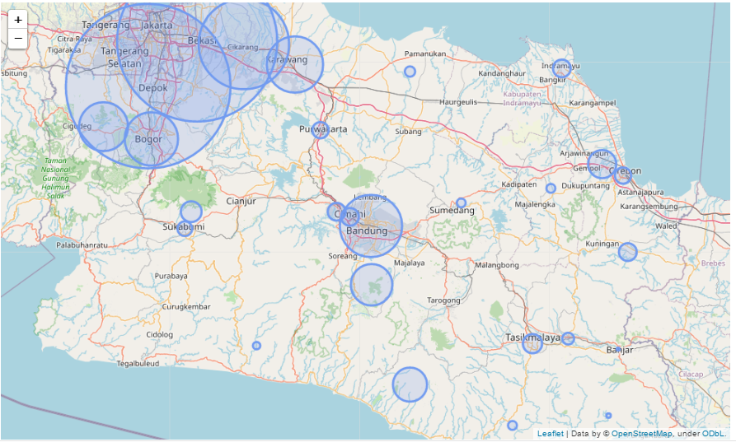
Results

Slide 8
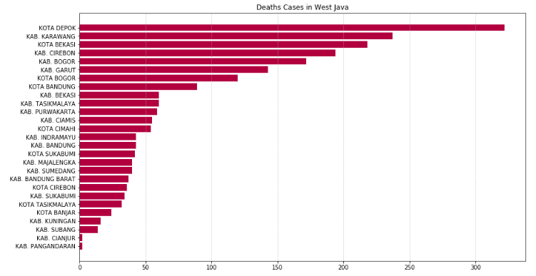
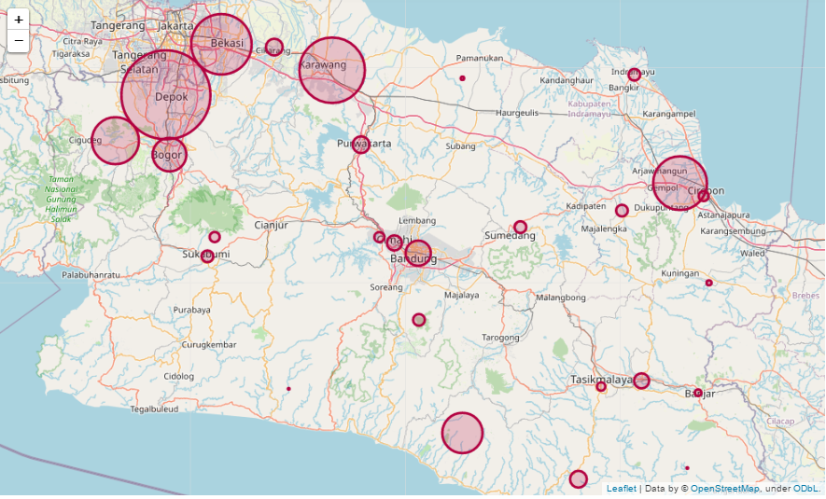
Results

Slide 9
For Fig. 4.3 and Fig. 4.4 it is the same as the confirmation case. Because both cities have high confirmed cases, it is very possible to recover as well as high, so it can be said that the high number of confirmed cases will be proportional to the high number of cases recovered, in terms of good health care.
Fig 4.5 and Fig 4.6 are similar to cured cases where case death will have a high probability of high confirmed cases.

Slide 10
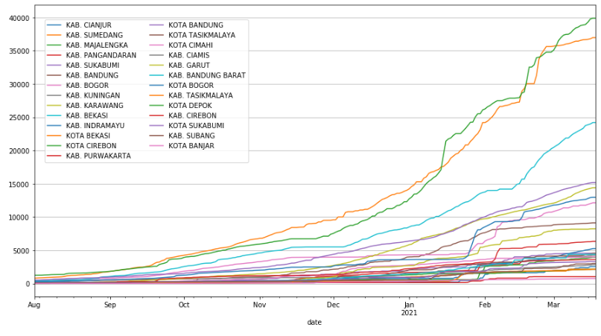
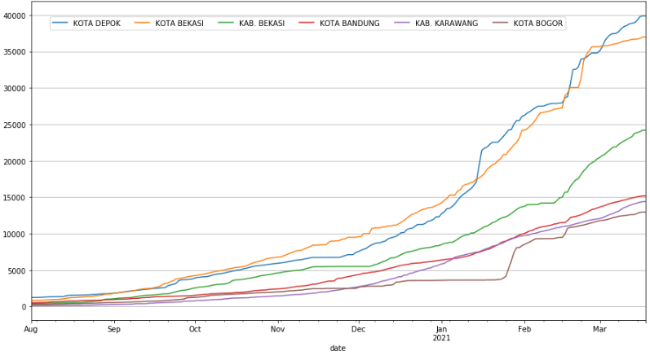
Results
Fig 4.7 and Fig 4.8 illustrates that there is an increase in cases per day from each regencies. The sloping of the resulting graph, the less daily case growth. Conversely, the steeper the graph, the greater the daily case growth.

Slide 11
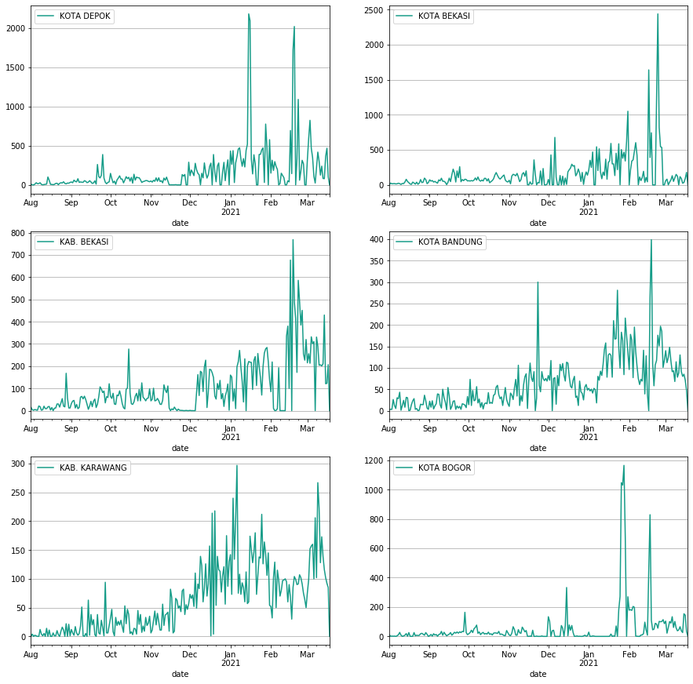
Results

Slide 12
Based on the graph above, the average growth of confirmed cases has increased in the last 4 - 5 months (November to now) even there is a sharp increase in a day. This is due to several factors but the factors that have a high probability are the fact that many WFO (for the employees in Jakarta) have been implementation of social distancing regulations have decreased so that there has been a spike in the last 5 months in the 6 regencies above.

Slide 13
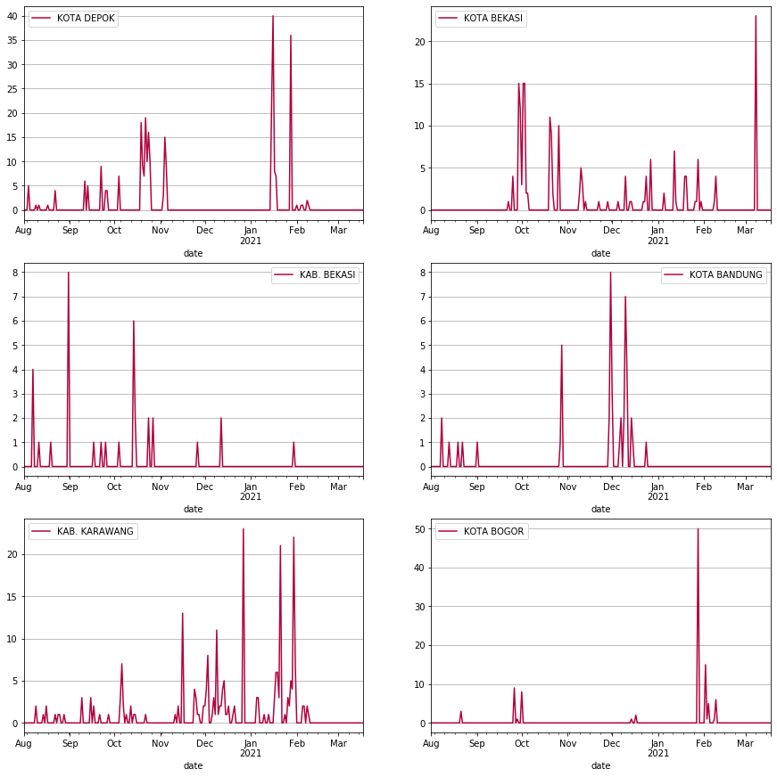
Results
Based on the graph above, the growth in cases of death due to Covid-19 is on average less in January to present. This is the success of the medical team and government in dealing with this pandemic.

Slide 14
Discussion and Recommendation
Based on the results that have been discussed, that the distance factor between cities is very influential on the growth rate of cases. Therefore, it is highly emphasized to comply with government regulations such as social distancing, wearing masks and frequently using hand sanitizers. This simple rule will be very helpful if we want to go out of town. Then from that APDA, maintaining the body's immune system is very necessary to avoid this virus.

Slide 15
Conclusion
High confirmation cases occurs in Depok city, Bekasi city, Bekasi regency due to the regencies is closer to Jakarta.
Total of recovered case has directly proportional to total confirmation cases for each regencies.
Daily cases of confimation cases increase on the last 5 months.
Daily cases of deaths cases decrease on January until now.

